Slide 1

Twitter Sentiment Classification
Nick Gigliotti

Slide 2
Business Problem
Create an accurate explanatory model that classifies tweets as expressing positive or negative sentiment.
Find out what people are saying about Apple and Apple products at South by Southwest, 2011.
Make some PR recommendations for the period immediately following the event.

Slide 3

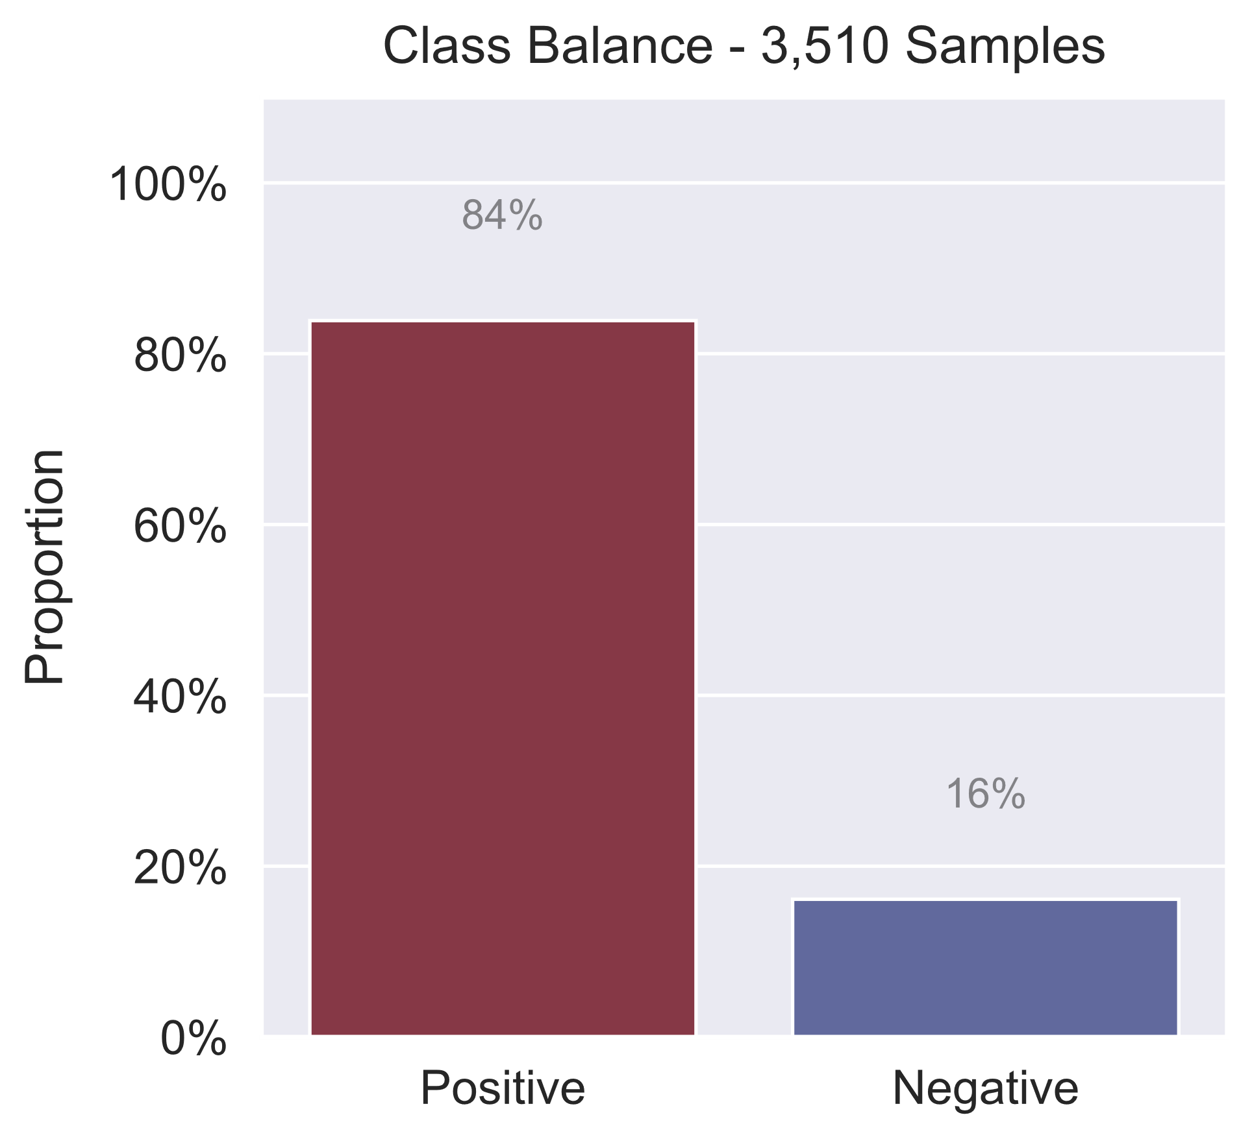
Dataset
Tweets related to South by Southwest, 2011
Annual conference and arts festival
Austin, TX
Major site for iPad 2 Launch
Crowdsourced sentiment labels
~3.5k tweets: just text and labels
Tweets are labeled with Positive or Negative
Sparse ‘Negative’ class
Tweets are labeled with brands and products related to the sentiment

Slide 4

Methods
Iterative Process
Finetuned BERT
Cleaning
Bigram Analysis
Searched for bigrams in whole corpus and for each brand
Predicted probabilities for each bigram
Generated word-clouds from probabilities
Beat Random Forest, SVM, Logistic Regression, Naïve Bayes
First developed a strong conventional model
Switched to fine-tuning a BERT (deep neural network)
Pretrained on Toronto Book Corpus and Wikipedia
Finetuned on this dataset
Used TF*IDF vectorization and VADER analysis
Removed duplicates, but left most retweets
Filled some missing brand names
Bidirectional Encoder Representations from Transformers
Minimal text cleaning before BERT
Considers context in both directions (hence “bidirectional”)

Slide 5
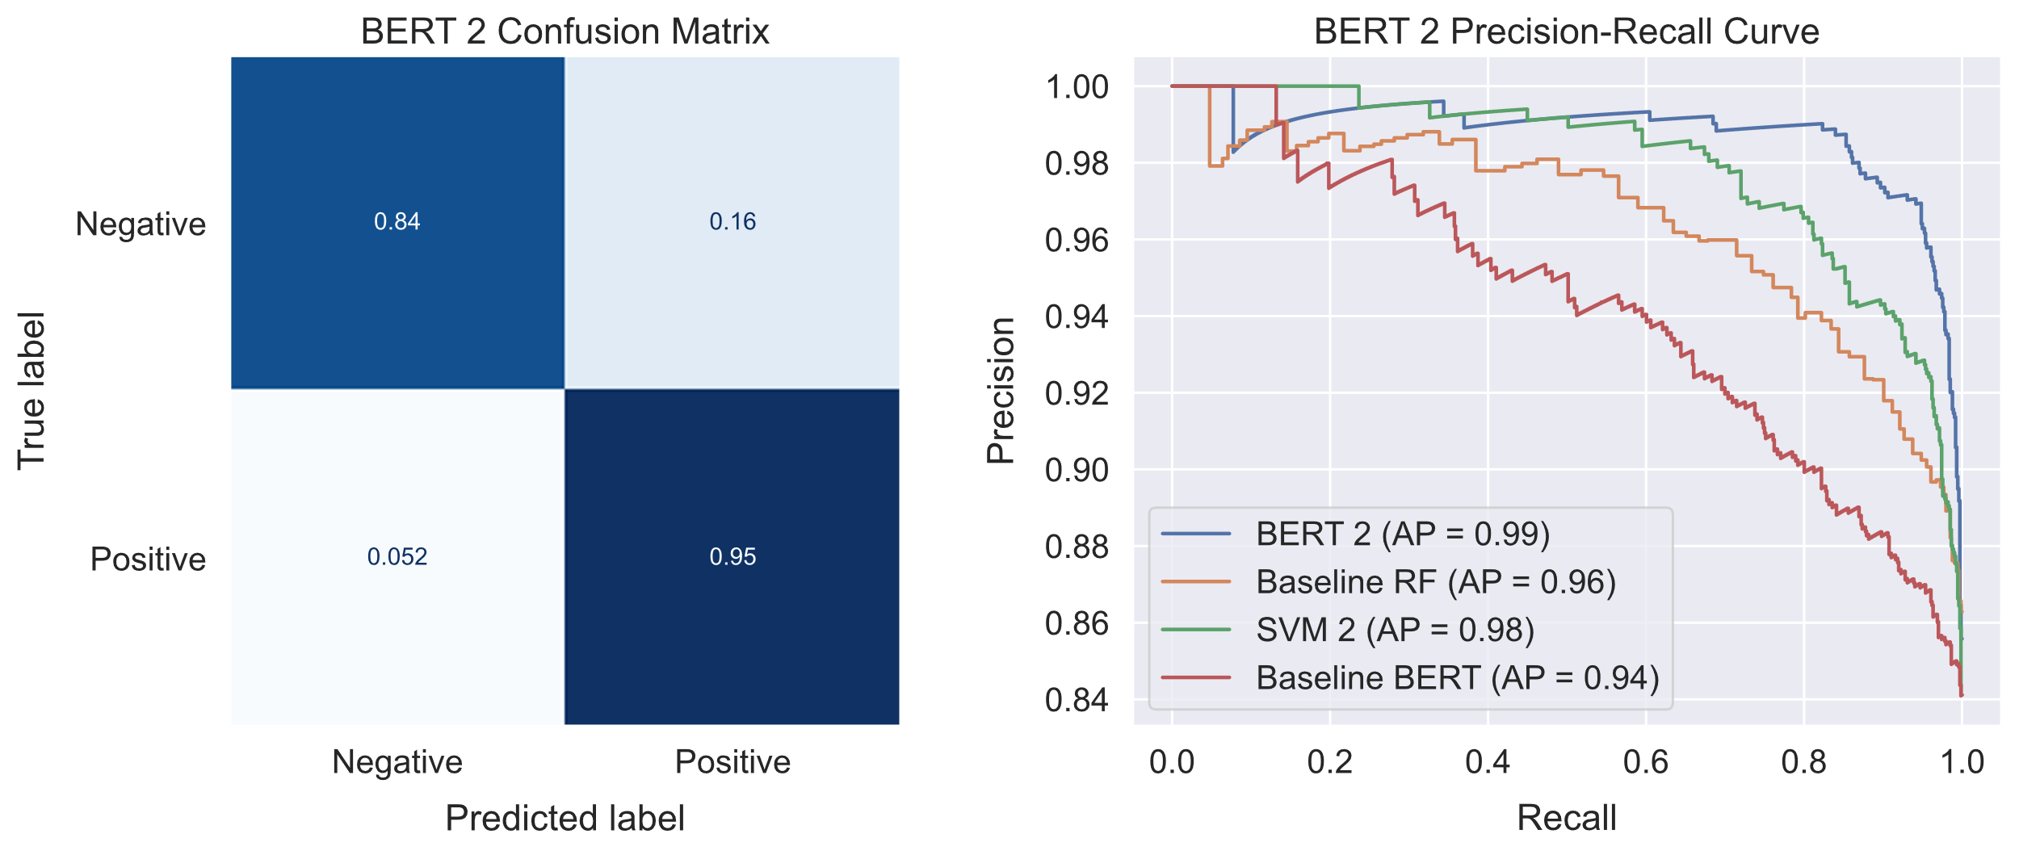
Model
Highly accurate despite small, imbalanced, dataset of 3,510 tweets.
Accuracy: 93%
Mean Recall: 89%
Widest Precision-Recall Curve
Almost never mistakes a positive for a negative
Rarely mistakes a negative for a positive

Slide 6
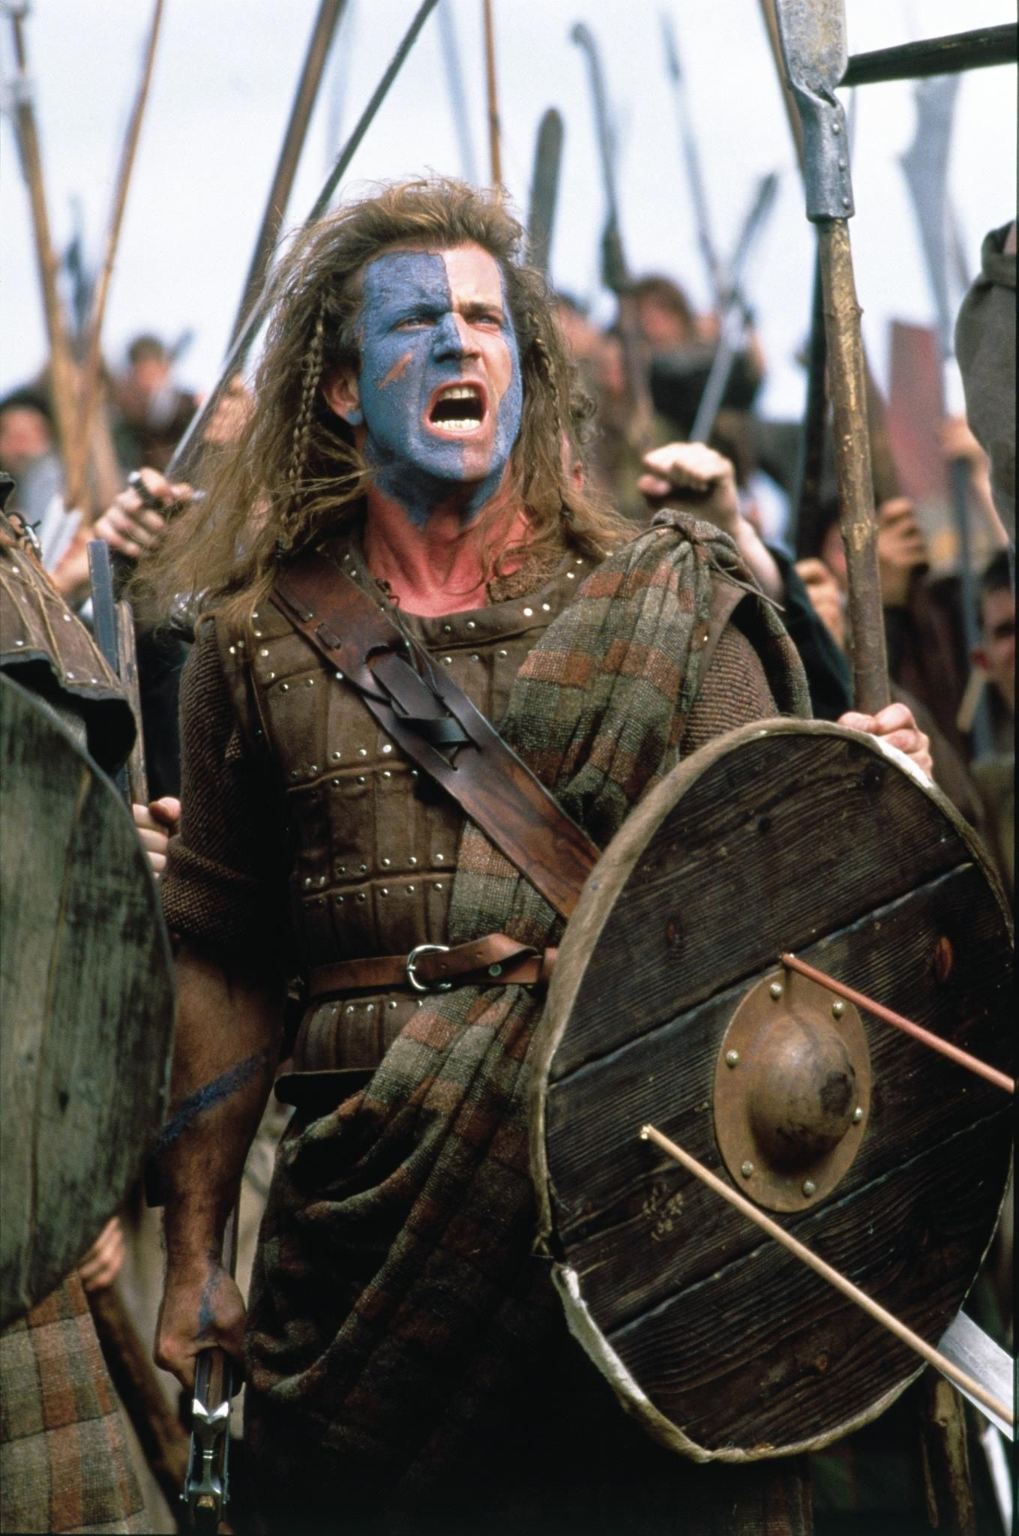
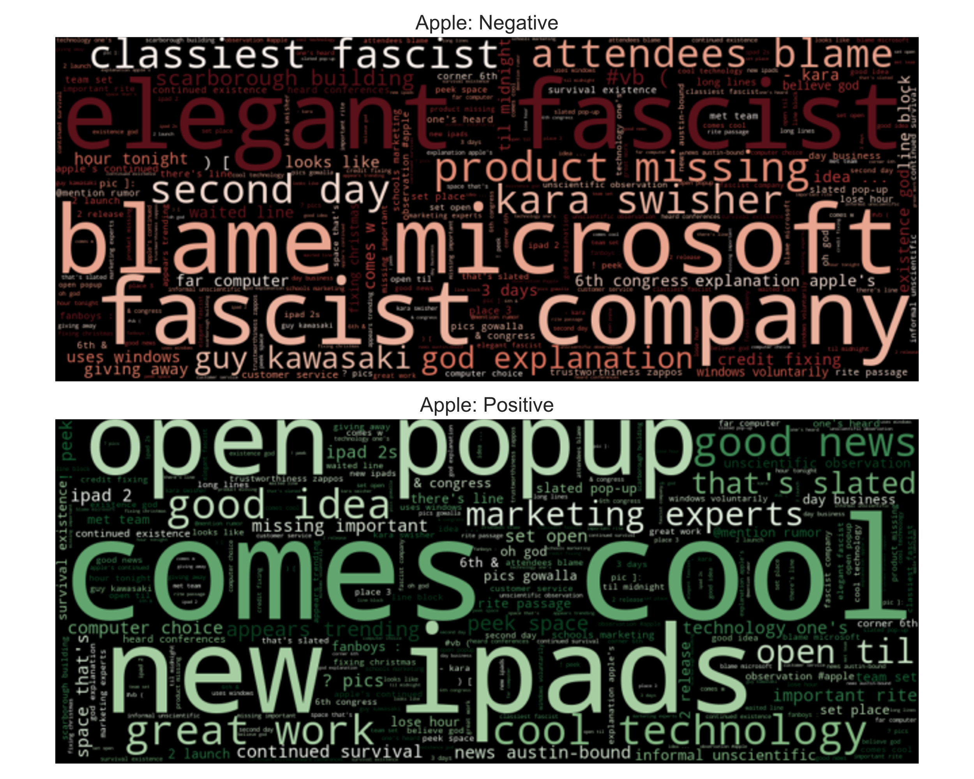
Freeeeedom! One of Apple’s values?
Recommendation:
Relinquish some control to send the message that people are free to use Apple’s products however they wish.
Apple is known for wanting total control of its products, even well after they leave the shelf.
The original comment was in response to the suggestion that Apple might create its own proprietary newsstand for e-magazines.
Flipboard: game-changer or just a fad? (2011)
At SXSW, Tech Reporter Kara Swisher called Apple “the classiest fascist company in America,” and it took off.
People were very excited about the “new iPads” and “cool technology” at the pop-up store.

Slide 7
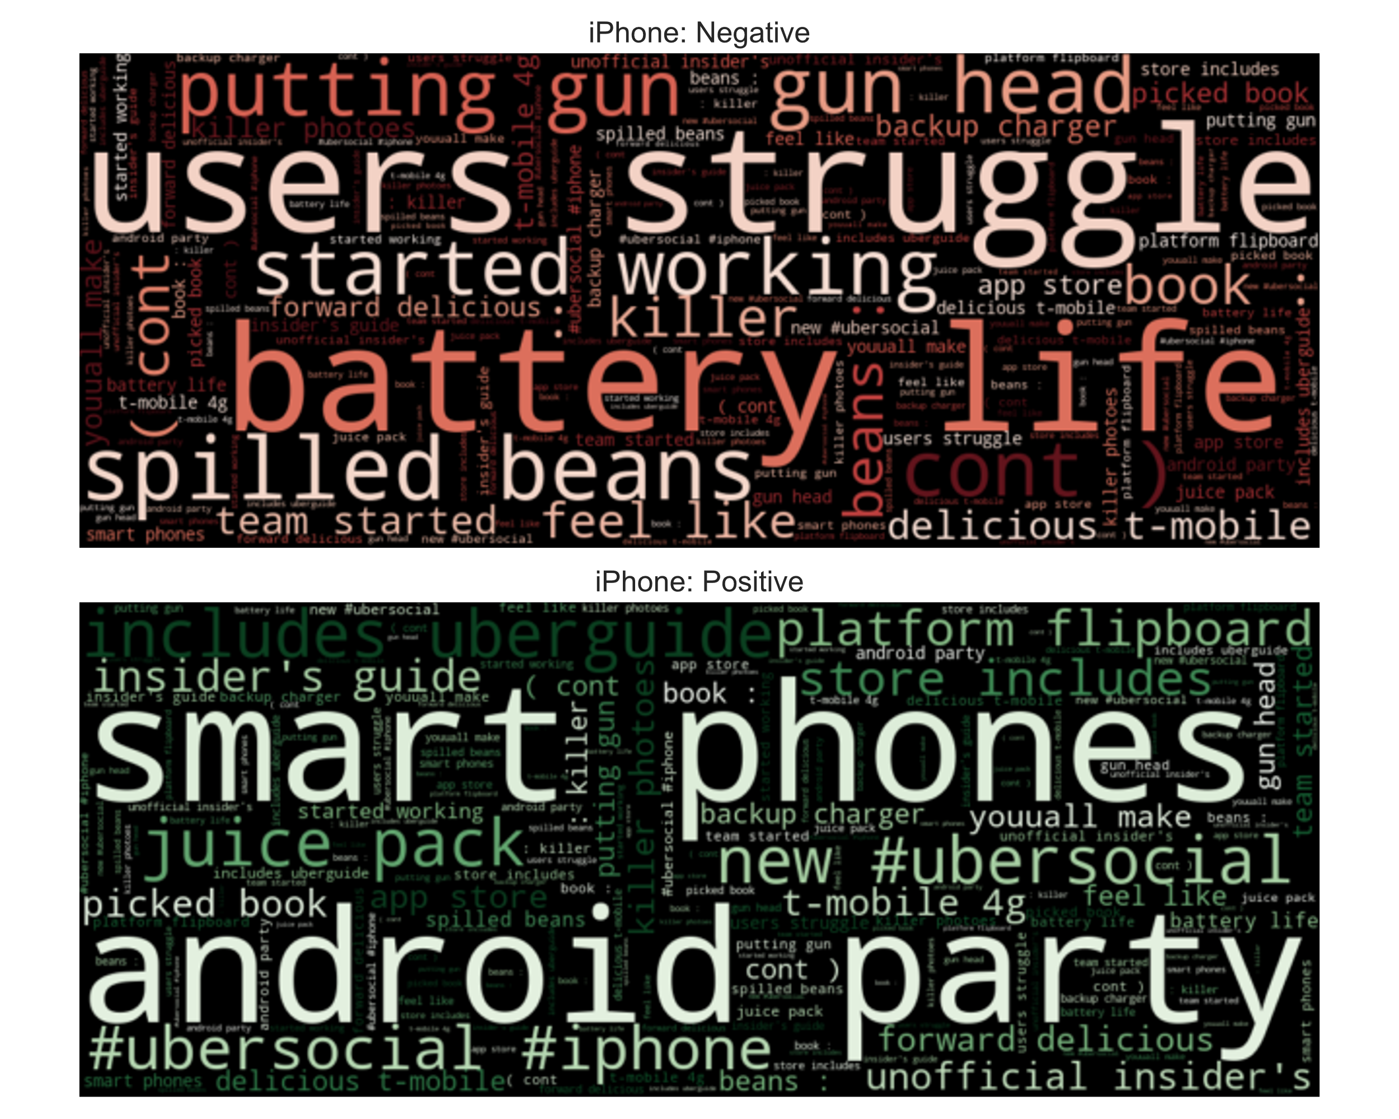
Complaints about iPhone Battery Life
Many people are complaining about the iPhone’s limited battery life.
Others are rejoicing at having a charger or “juice pack.”
Some people mocked the spotty AT&T service which many iPhone users have.
You already solved this problem by making a deal with Verizon.
Recommendation:
Improve the iPhone’s battery life and turn it into a new marketing campaign. People will pay attention.

Slide 8
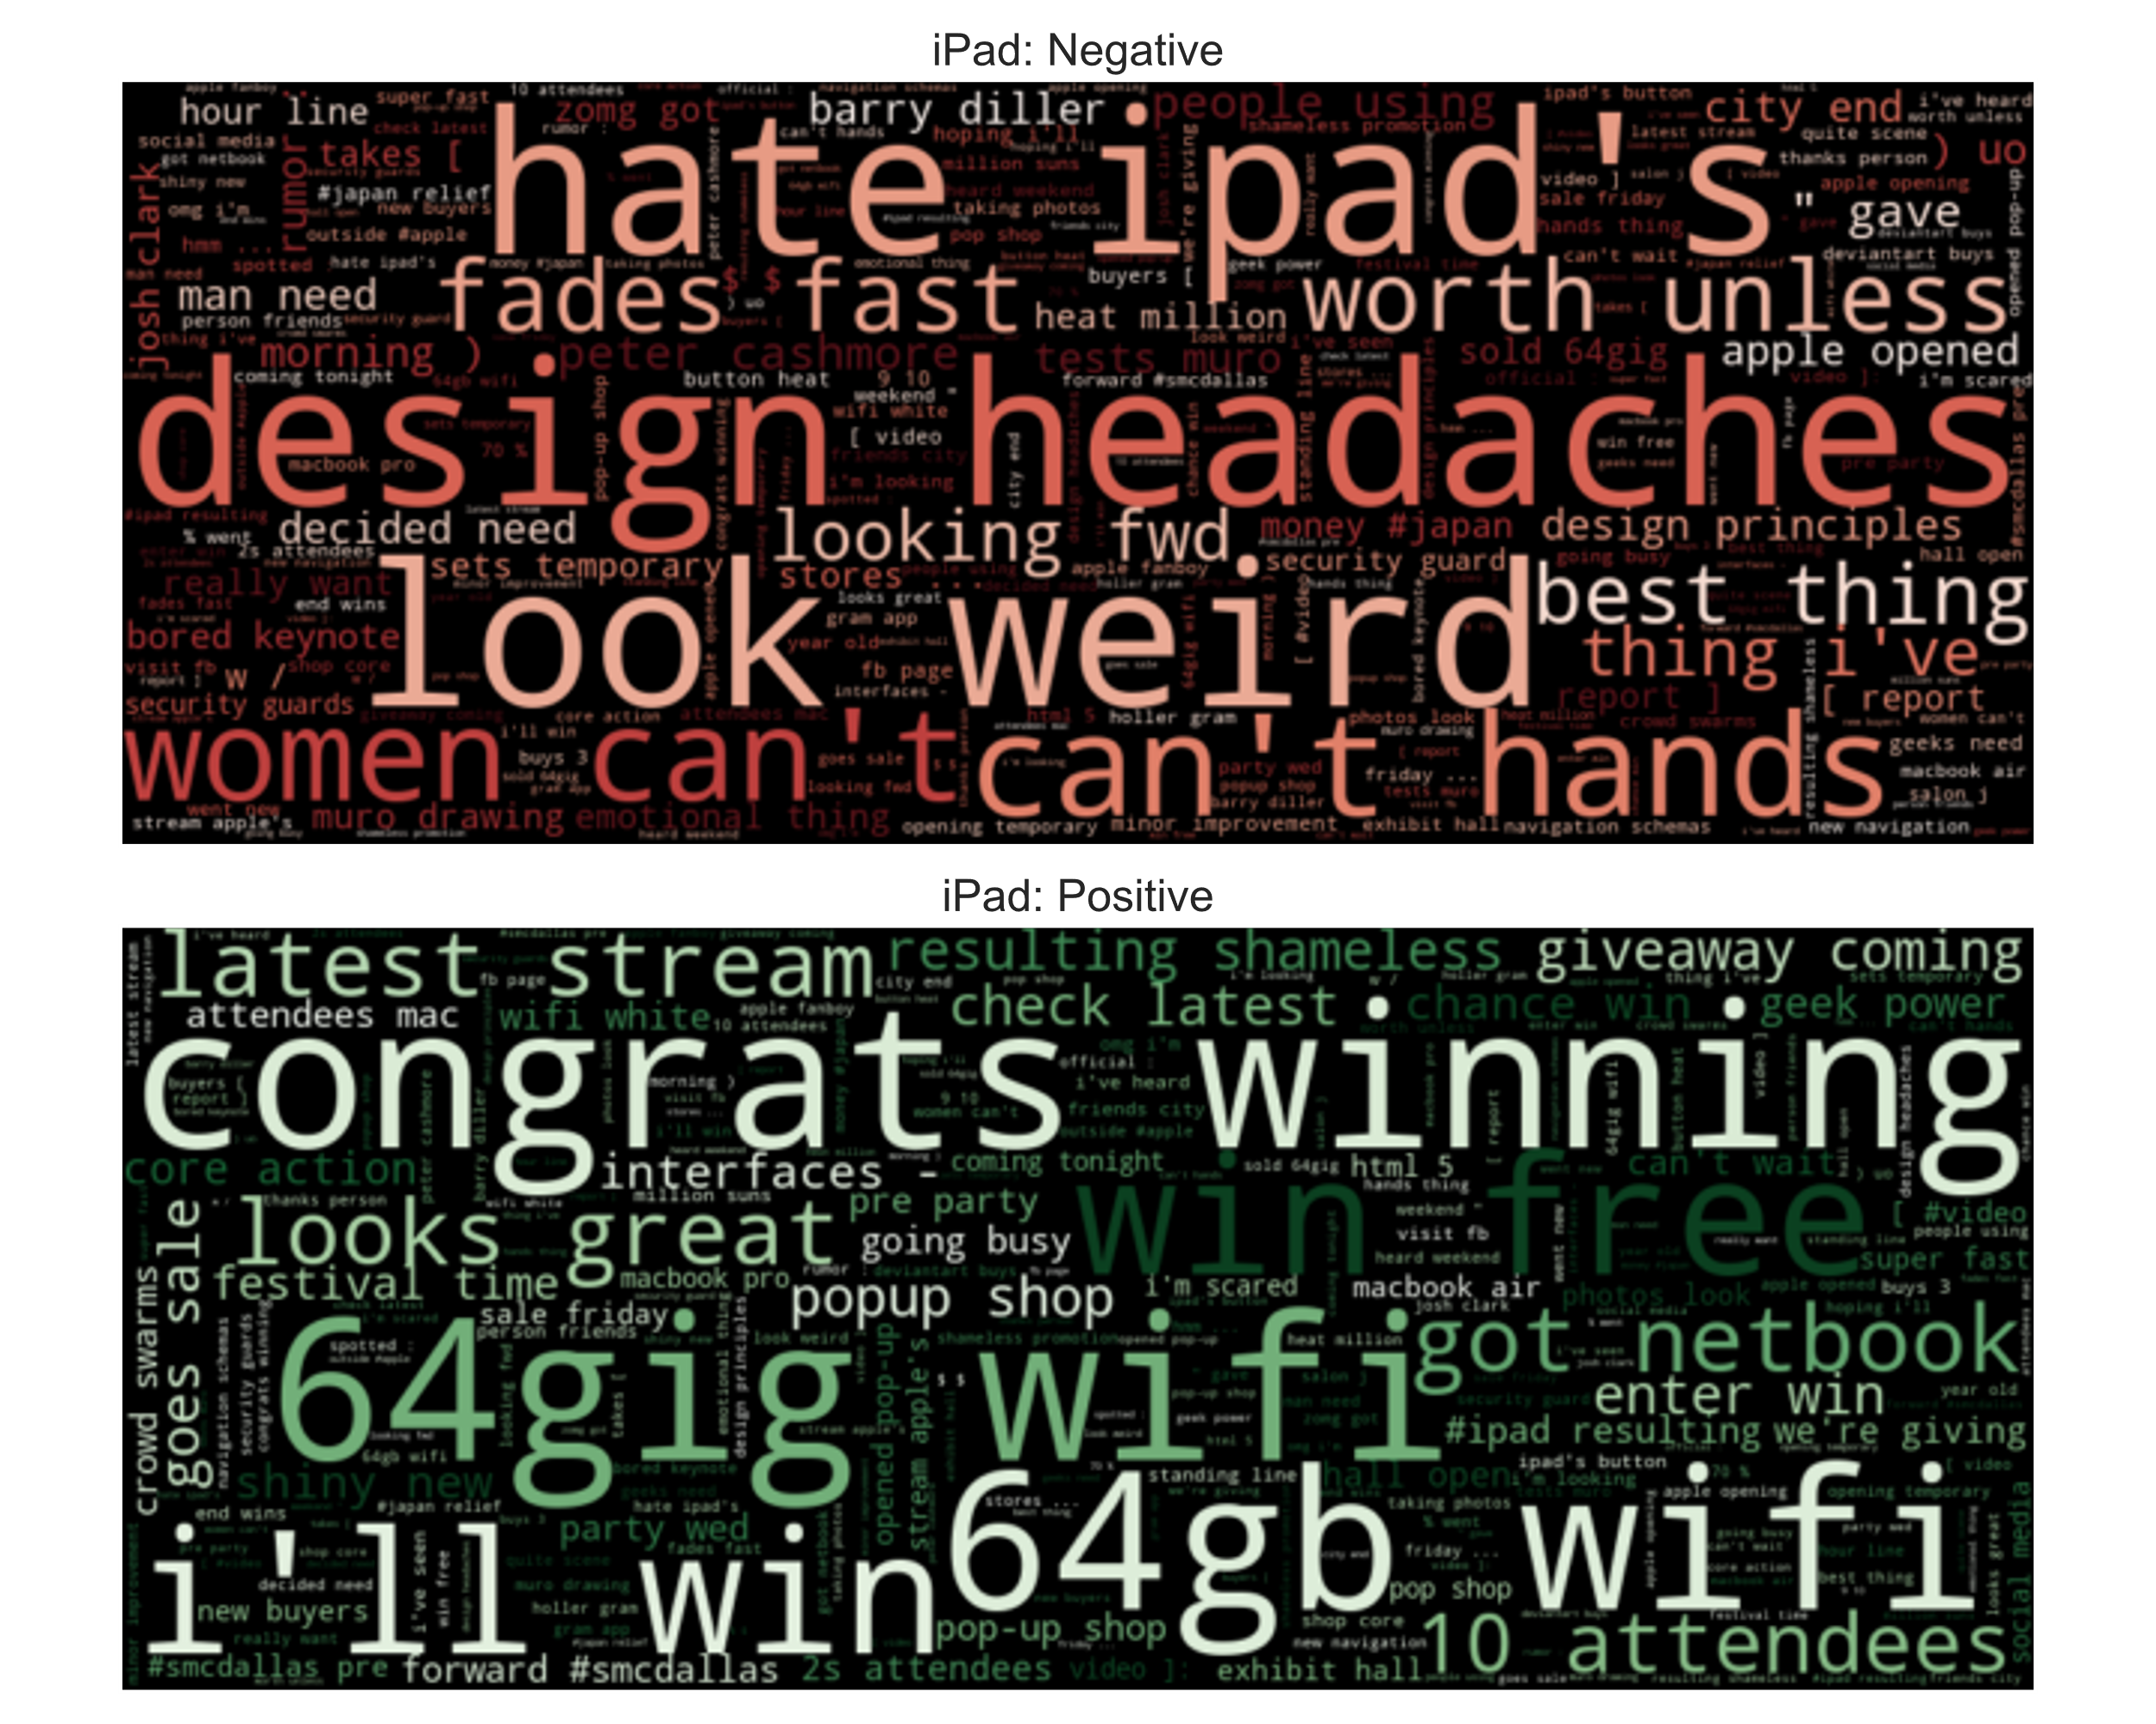
iPad 2 Popup Store was a Success
People couldn’t stop talking about the iPad 2 popup store.
“64gig wifi” is a top phrase because everything but that model sold out.
“Congrats winning” and “win free” have to do with an iPad case giveaway, which people liked.
People said that others “look weird” using iPads to take photos.
“Design headaches” and “hate ipad’s” have to do with a benign talk given about iPad app design.
“Worth unless” comes from a claim that the iPad 2 is only a minor upgrade and not worth the price.
Recommendation:
Do another temporary popup store for your next big product launch.

Slide 9

Conclusion
I built a 93% accurate model despite a small and noisy dataset.
There is still room to improve the model, though it’s probably not necessary.
I have four recommendations:
Send the message that Apple cares about individual freedom by relinquishing control in a public manner.
Improve the iPhone’s battery life and use it as a rallying point for a marketing campaign.
Open another temporary popup store for your next big product launch.
Give away free refreshments at your events. Phrases like “free food” and “free drinks” were associated with the positive class.

Slide 10

Future Work
Stacking Classifiers
Combine the results of multiple classifiers to make a better conventional model.
Probably not necessary given the success of BERT.
BERTweet
Try using BERTweet, a pretrained BERT designed specifically for English tweets.

Slide 11
Thanks
Nick Gigliotti
ndgigliotti@gmail.com

